Slide 1
Hash Match
Hash algorithm is used to compare the similarity of images
Course Title Image Processing
Professor Kwang Nam Choi
Team Name YSWL
Date 2021. 11. 10

Slide 2
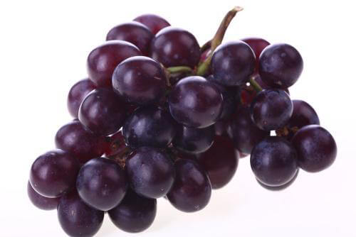
This is a picture of a grape！

Slide 3
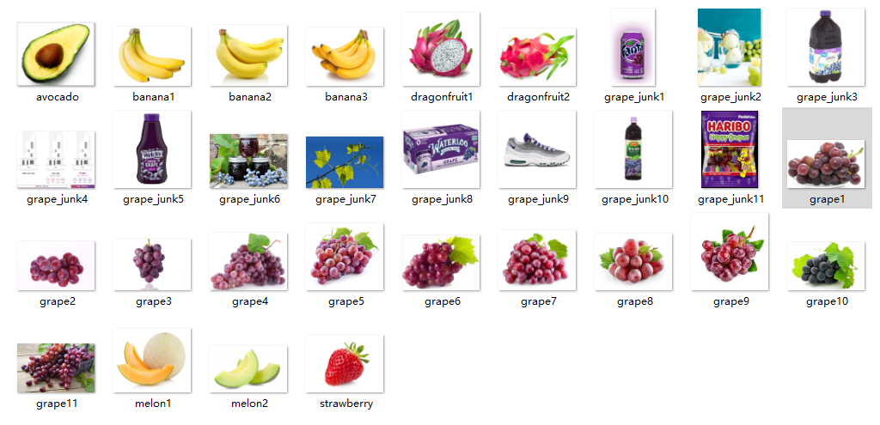
How to find similar pictures in this pile of pictures？

Slide 4
Our plan！
Hash Match + Hamming Distance

Slide 5
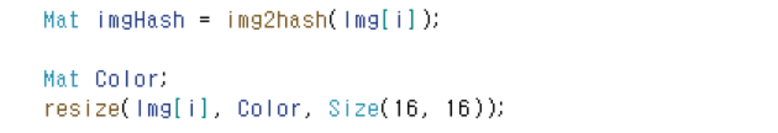
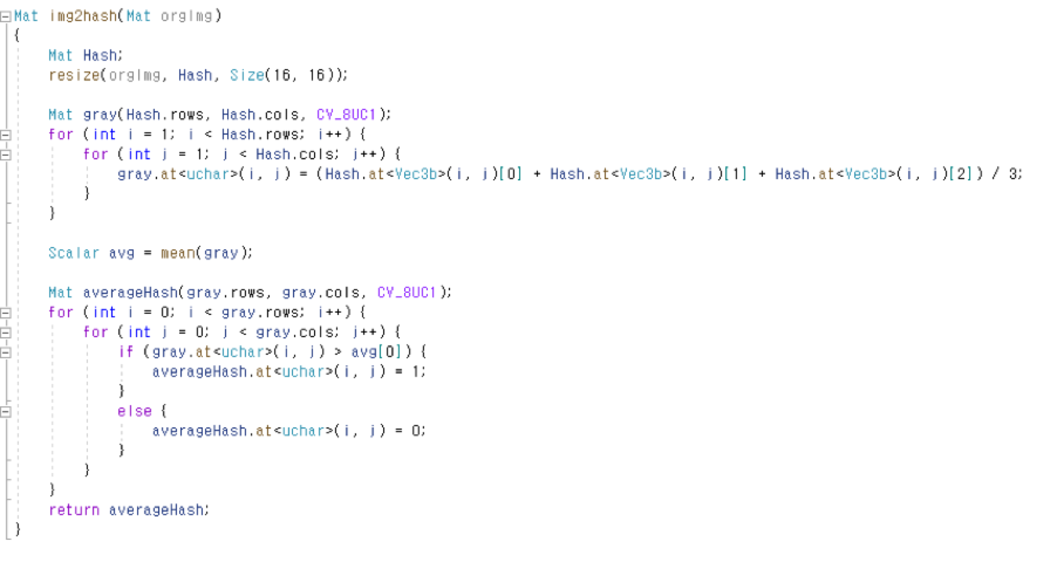
Hash Match

Slide 6
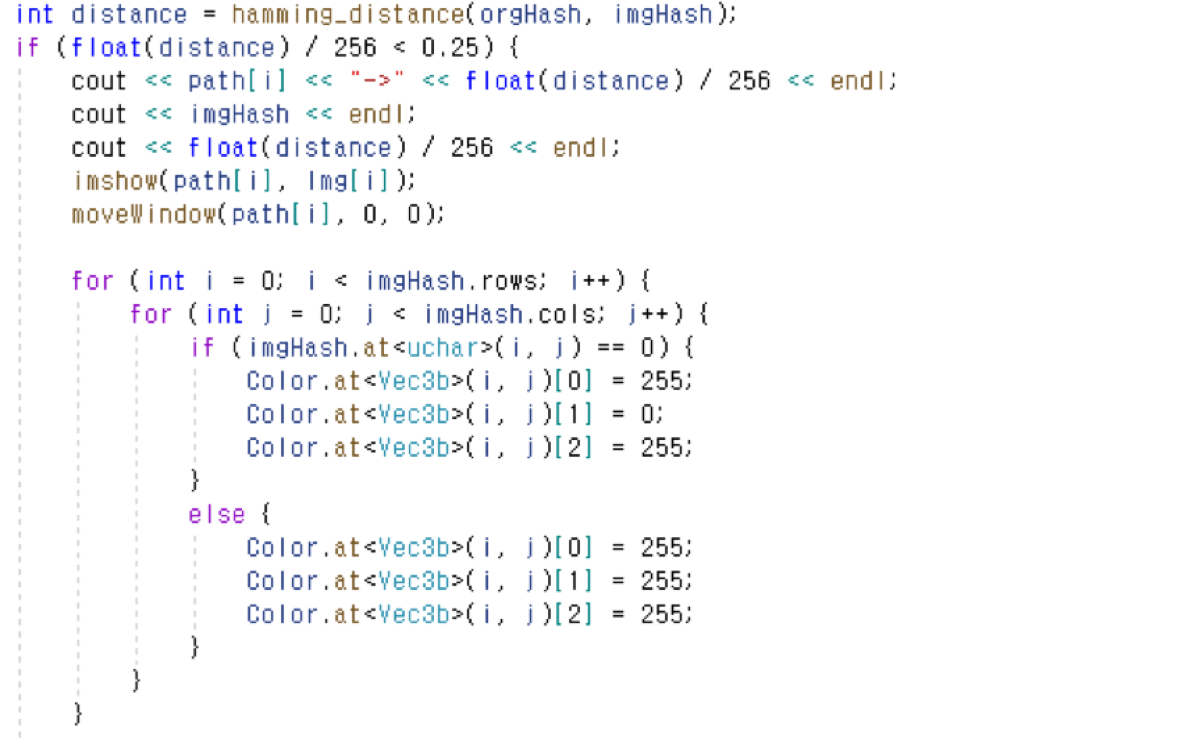
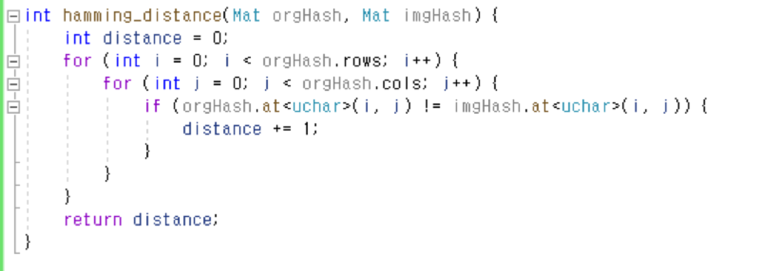
Hamming Distance

Slide 7
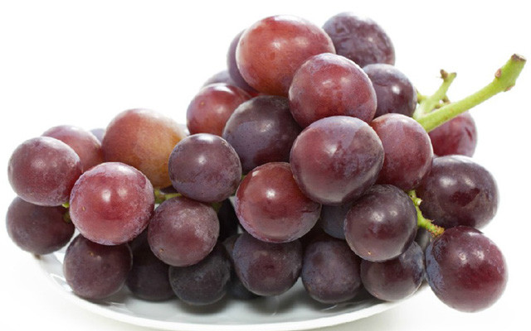
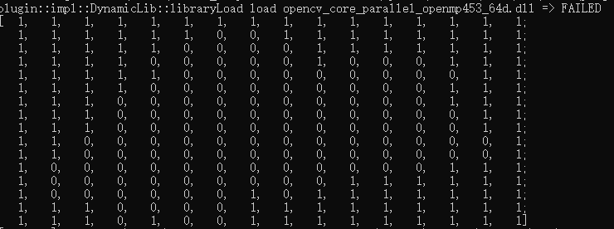
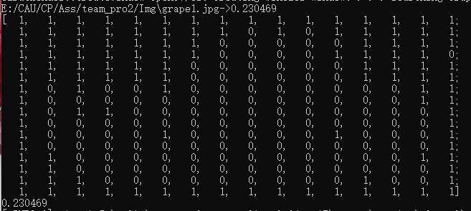
Like this！

Slide 8
We search the pictures in turn and get similar pictures. (Red border)
First
Last

Slide 9
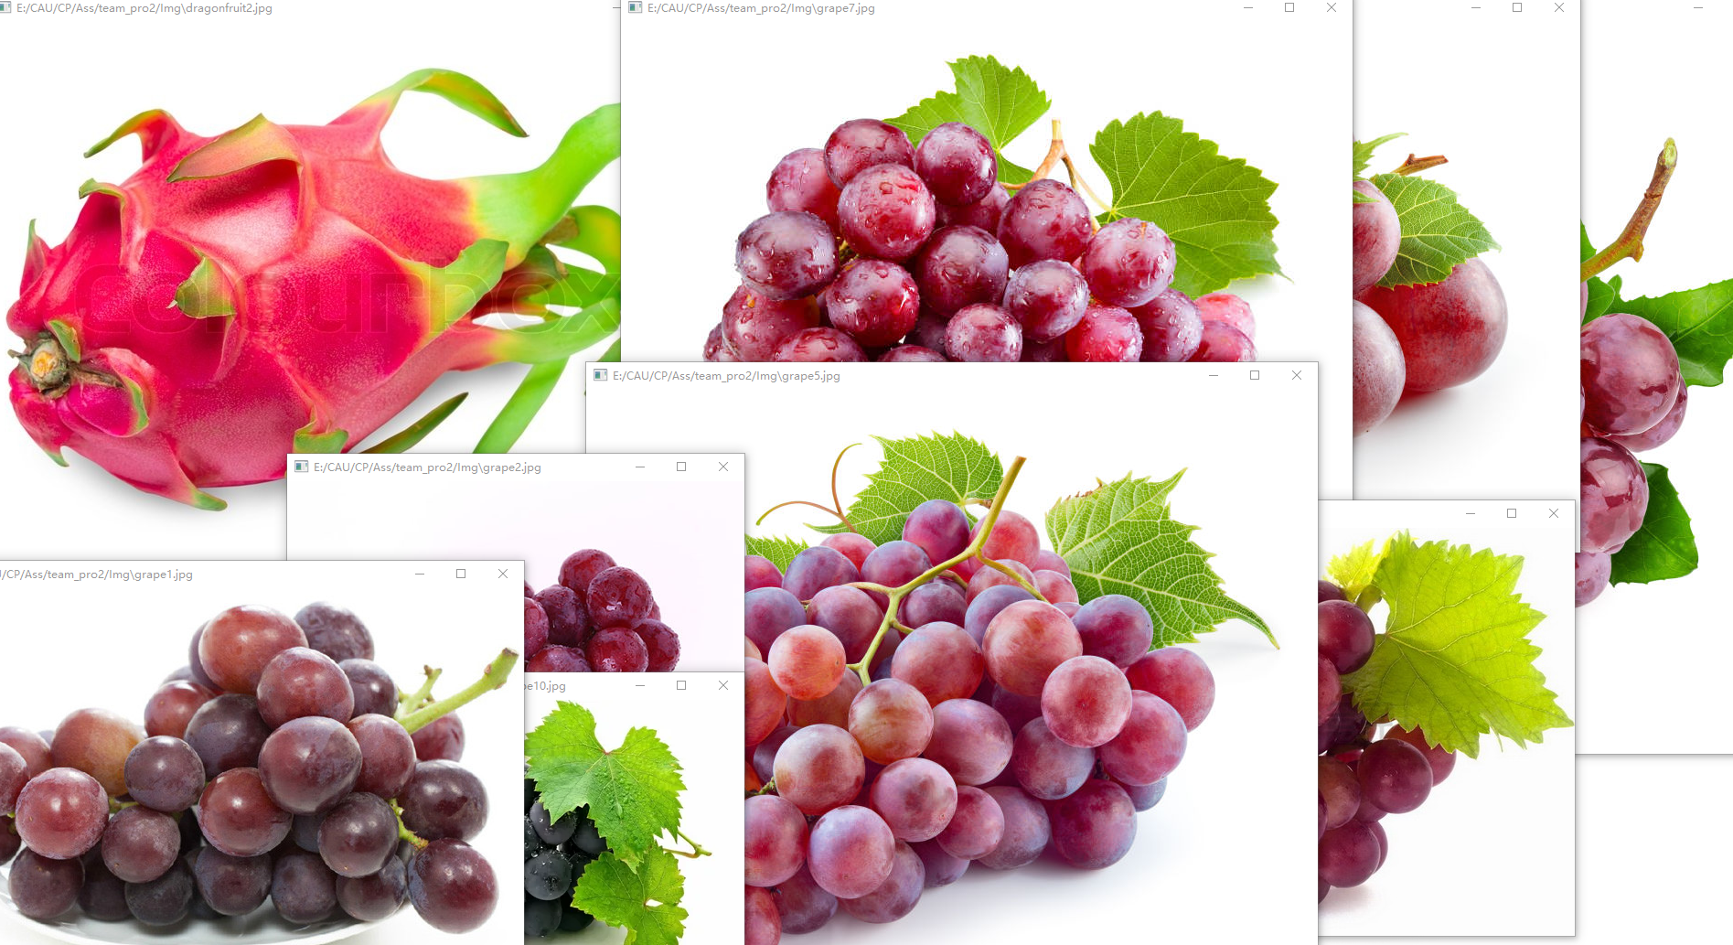
Similar images found by code run results.

Slide 10
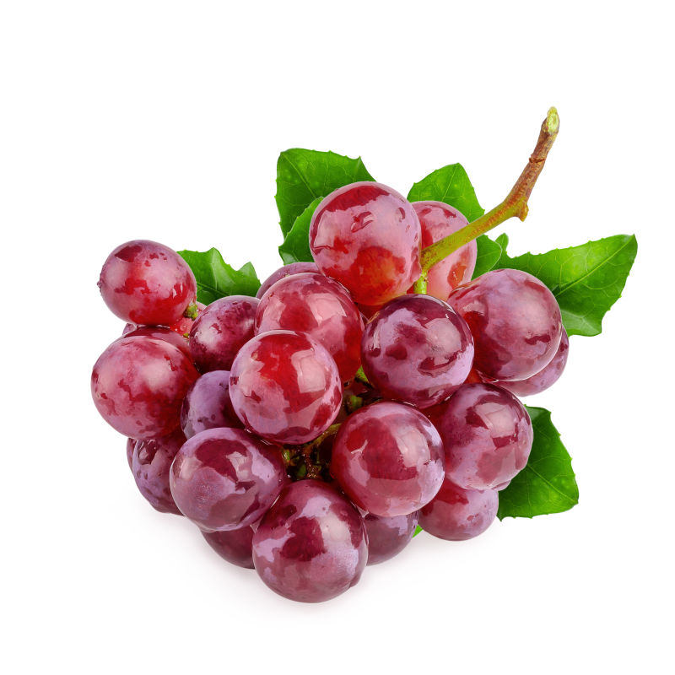
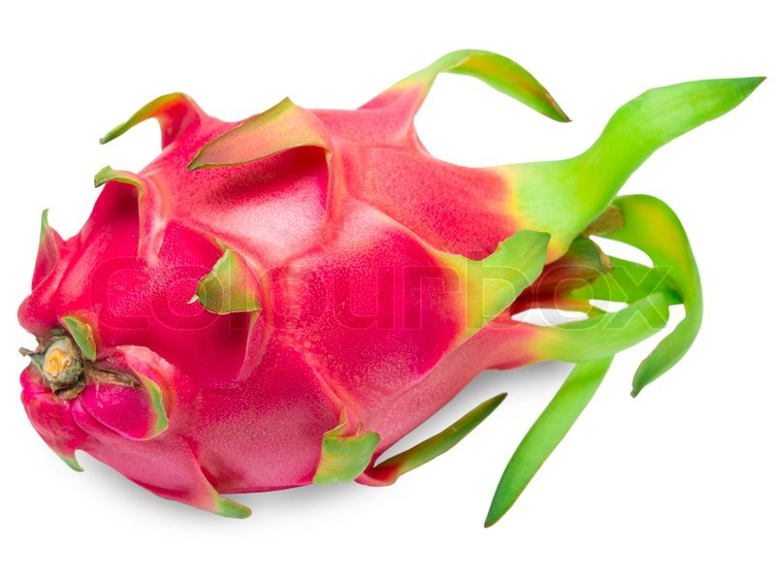


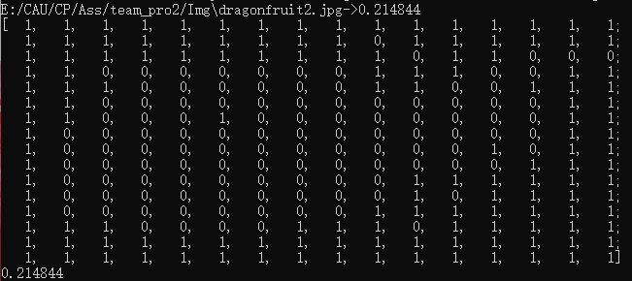
But！There was an error.
Right
Wrong

Slide 11
Thank you!
Teammate:
(KOR)유승신 20150413
(KOR)이주영 20192455
(CHN)왕생봉 20191335
(KOR)서정현 20151224

